Slide 1
Identifying Physical Sources Affecting Aquifer Water level Fluctuations with NMFk
Paper Review of Boian S. Alexandrov et al. “Blind source separation for groundwater pressure analysis based on nonnegative matrix factorization”
Abimbola Oluwade | 08/03/2020

Slide 2
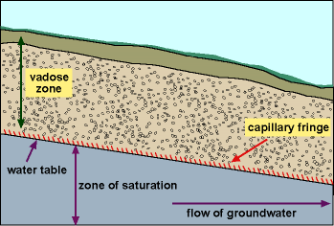
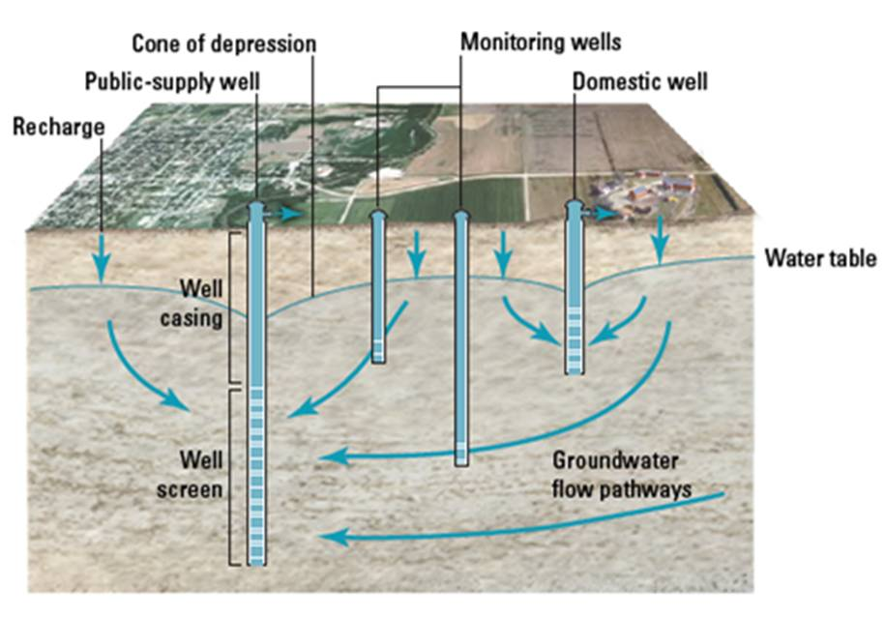
Objective and Background (Pgs. 1-4)
Identifying physical sources causing fluctuations in water level of aquifers
Why?
This information allows evaluation of aquifer recharge, estimation of surface/subsurface water interactions etc.
Typically, these are the sources that can cause the observed water-level fluctuations: municipal water-supply pumping, seasonal recharge fluctuations, barometric pressures propagating through vadose zone and boreholes, surface/subsurface water interactions, etc.
If the pressure head signals at the observation wells/points can be obtained, then the properties controlling the fluctuations from the other factors can be analyzed i.e the pressure signals can serve as the water level info

Slide 3
Objective and Background (Pgs. 1-4)
Ways to identify the sources causing pressure fluctuation at observation points:
Simulations from different physical parameters. Creating a complex physics model (ill-posed, too many unknowns and computationally expensive)
Statistical means e.g PCA, Correlation, regression, etc. (some data may be correlated and hard to catch)
Blind Source Separation(BSS): cock-tail party problem (good but it can only identify the manifestation of the source signal at the observation points; it can’t identify the source location itself and its strength at that location; also, it is ill-posed as the r is unknown)
ICA (looks for the maximized statistically independent non-gaussian sources that reproduce the experimental data)
NMF (enforces a non-negativity constraint on the two output matrices, S & A)

Slide 4
Objective and Background (Pgs. 1-4)
The paper deals with Blind Source Separation (BSS)
Why is NMF better than ICA for the dataset?
Physical properties like energy, pressure, frequencies are naturally non-negative so NMF would be a good candidate
Since physical parameters are being measured, there could be dependencies in the data due to seasonality and ICA would not capture that (it will return one source instead of two or more sources since it is looking for statistically independent sources)
Easier to physically interpret due to sparsity in result
The issue with NMF is that you need to know r before hand hence NMFk

Slide 5

NMFk Methodology (Pgs. 4-7)
Consider an aquifer with m observation points measuring pressure heads (no. of samples)
There are r unknown physical sources causing the pressure/water-level fluctuation
p discrete measurement are taken at each observation point (no. of features)
Our problem becomes:
Some notes:
Do not worry about alteration of signal at it travels from source location to observation point
Assumption: The source signals are proportionally manifested at each observation point*
BSS Cocktail-party problem analogy

Slide 6

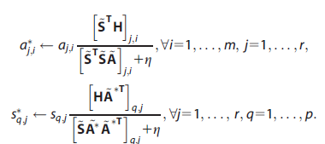
NMFk Methodology (Pgs. 4-7) contd.
Cost function: minimize the Frobenius norm
Gradient Descent: multiplicatively update the two matrices one at a time
Note: η = 10⁻¹⁶ is applied to force all elements to be greater than a small positive number (avoid zeros & division by zero)

Slide 7

NMFk Methodology (Pgs. 4-7) Contd.
Obtaining the best number of sources, r
NMFk analyses m independent solution sets. For a certain solution set, say m=2, there will be r=m=2 sources and n number of solutions of S(p,r) & A(r,m)
For each solution set, NMFk deals with S and A separately. For S, it creates r clusters using K-means clustering with cosine dissimilarity (1-cosine) and groups all the columns of the n S solutions into the r clusters. NMFk then finds the average of all the columns/members in one cluster (centroid of the cluster)
That becomes the average solution Sª for that solution set. Note that Sª(p,r) have columns that are the averages/centroids of the clusters.
Same thing is done to A too to obtain the average A, Aª using K-means clustering but here NMFk groups rows instead of columns
As a result, we obtain a series of m average solutions ([S₁ª, A₁ª],[S₂ª, A₂ª],[S₃ª, A₃ª],...,[Sª_{m_samples}, Aª_{m_samples}] each with a different number of r (1; 2; 3;. . . ;m_samples).

Slide 8

NMFk Methodology (Pgs. 4-7) Contd.
For each solution set, a Silhouette value and average Frobenius reconstruction error is obtained
Recall there should n members/columns in 1 cluster and there are r clusters in each solution set. Each column is compared with other columns in its cluster using cosine similarity. The average of all these similarities are computed and called a_{d}. Then this same column is compared with the members (columns) of the other clusters. The similarities for the other clusters are then averaged out and called b_{d}. So for each column (element of a cluster) we will have a_{d}(average of the similarities between members of its cluster) and b_{d}(average of all similarities between members of all the other clusters). Then a silhouette score c_{d} is computed thus:
The silhouette value of each specific cluster is found by averaging c_{d} values of all the members of that cluster. Then the Silhouette value for that specific solution set is the average of the Silhouette values for all the clusters.

Slide 9

NMFk Methodology (Pgs. 4-7) Contd.
Average Silhouette value ≈ 1, indicates tight and reproducible clusters; value ≈ 0 is opposite
Frobenius reconstruction error is also calculated. Basically error = [H-(Sª*Aª)]/H
The solution set value for which silhouette score is high and the error is low in comparison with the others is chosen. The Sª&Aª for that particular set and its r is selected as the best solution.
NMFk permits signal to noise ratio calculation for each sample:

Slide 10
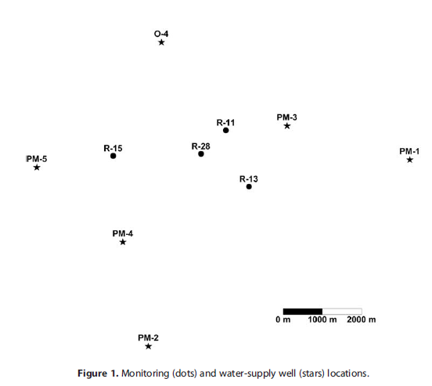
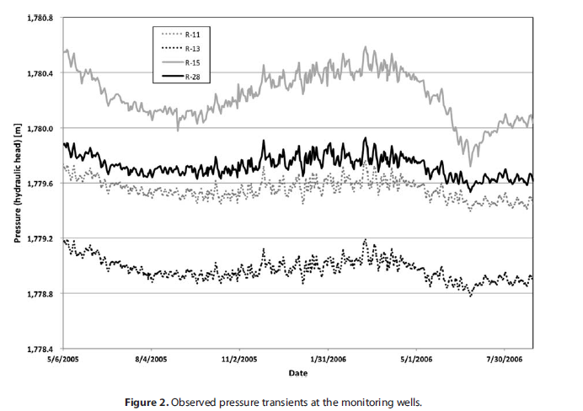
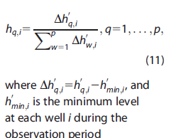
Application of NMFk to Hydrogeological Data (Pgs. 7-8)
Pressure data were collected at 4 monitoring/observation wells within the regional aquifer beneath the LANL site (m=4)
Data was collected between 6 May 2005 and 27 August 2006
For each day of this period, observations were taken hourly then averaged to obtain daily records with p=481 data points
The pressure records of R-11, R-13, R-15, and R-28 denote
h1, h2, h3 and h4 respectively.
All the 481 datapoints in each h are normalized to obtain the H matrix fed into NMFk

Slide 11
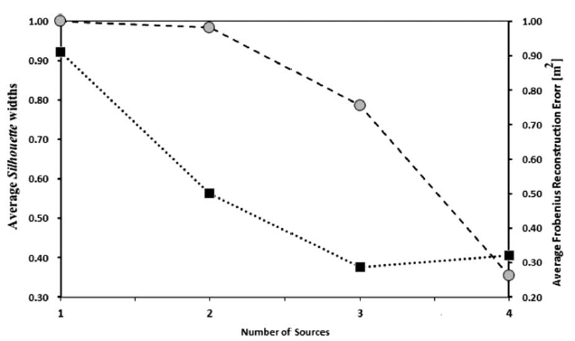
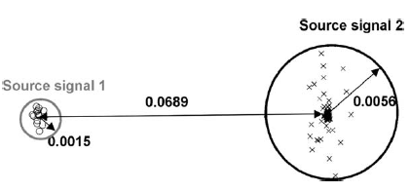
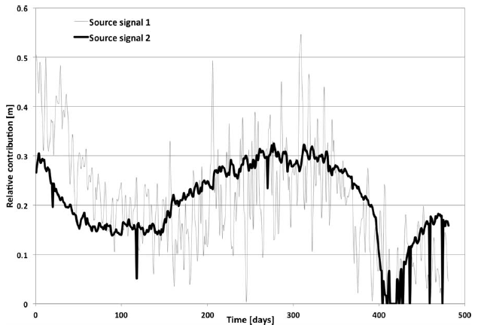
Results (Pgs. 8-16)
Obtained m solution sets with r=1,2,3 & 4 respectively
200 solutions were obtained for each solution set (n=200) and the number of iteration steps is 10⁶ for each solution
Silhouette scores and Frobenius reconstruction errors were calculated for the 4 solution sets
2 sources (r=2) was selected based on the above values
Reconstructed H has correlations of 0.991, 0.976, 0.986, and 0.978 for each sample h1,h2,h3,h4 respectively signifying high quality reconstruction
SNR ≈ 16 000, 10 000, 32 000 & 5 000 for h1,h2,h3 & h4 signifying good result

Slide 12
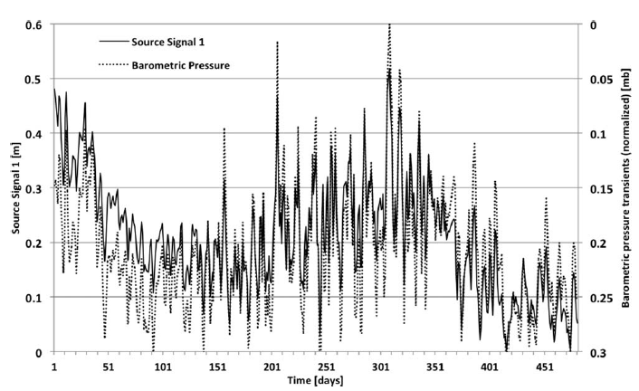
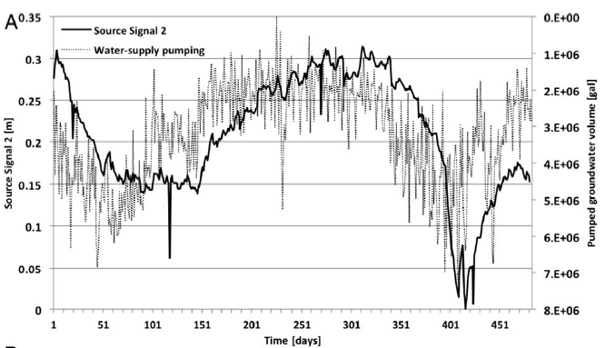
Results (Pgs. 8-16) Contd.
Two source signals were found to be related to barometric pressure effects and the water-supply pumping, respectively
First source signal has ≈ -0.85 correlation with the barometric pressure effects
The second source signal matches the water-supply pumping signal (see image). Note the 20 days lag

Slide 13
Results (Pgs. 8-16) Contd.
Another important conclusion: there are apparently no strong signal in the observed pressure data caused by other factors such as variability in infiltration recharge or surface/subsurface water flow
Very thick vadose zone of ≈ 300m might be the reason

